Slide 1
C-presentation

Slide 2
GROUP-12
01
02
03
04
Guna
Madhav
Santhan
Nilavarasan

Slide 3
QUESTION
Develop and implement a C Program for image thresholding

Slide 4
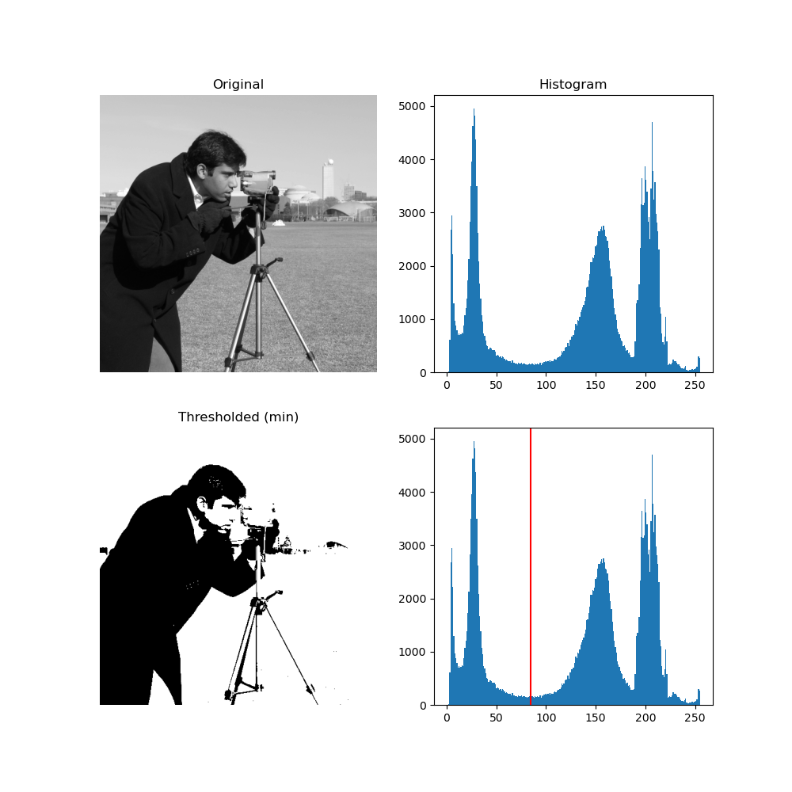
AIM OF THE PROJECT:
Global thresholding means we assign to all pixels with values below the threshold a value, which is zero, else we assign a value which is maximal (255 for an 8 bit pixel)

Slide 5
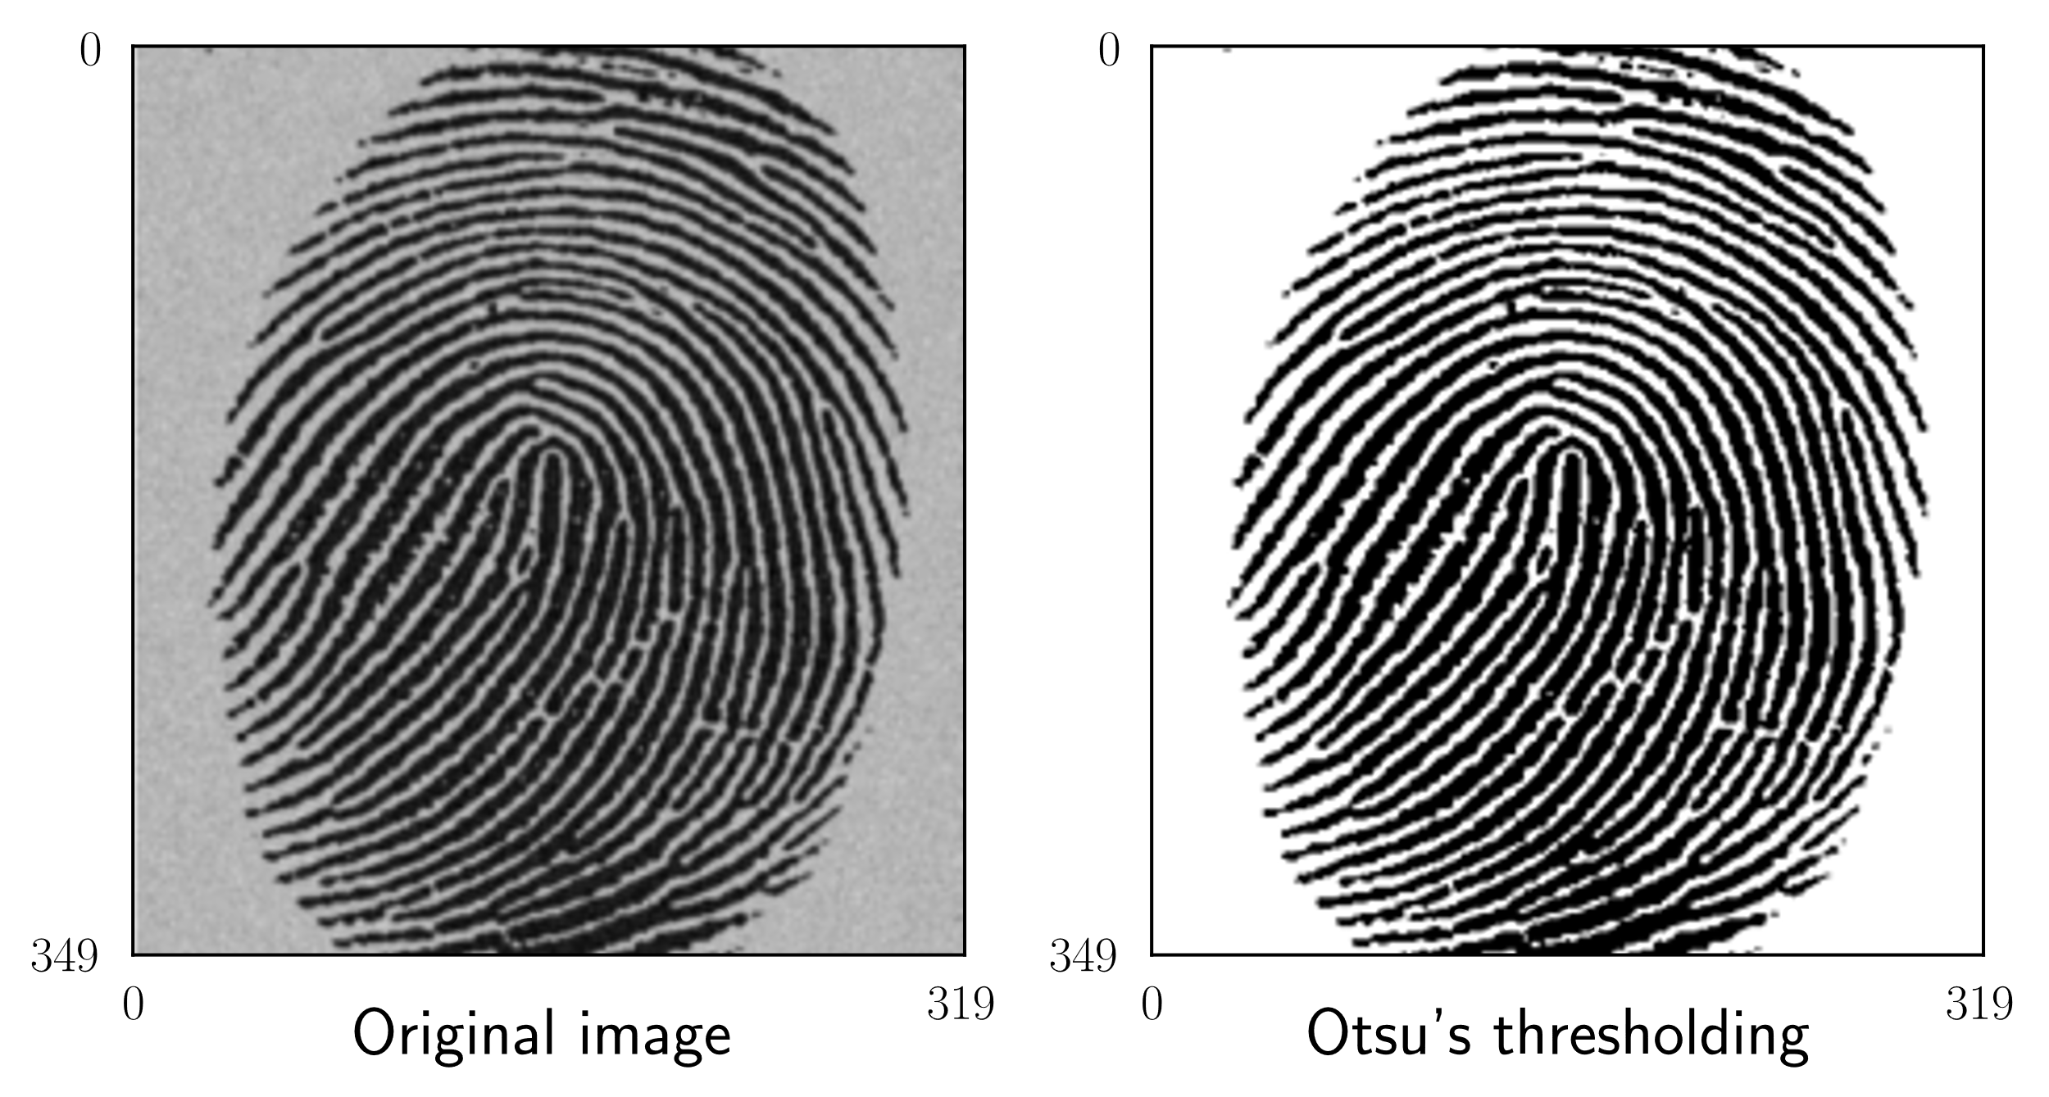
Some examples of an original black and white,and the threshold image of it…………………..

Slide 6
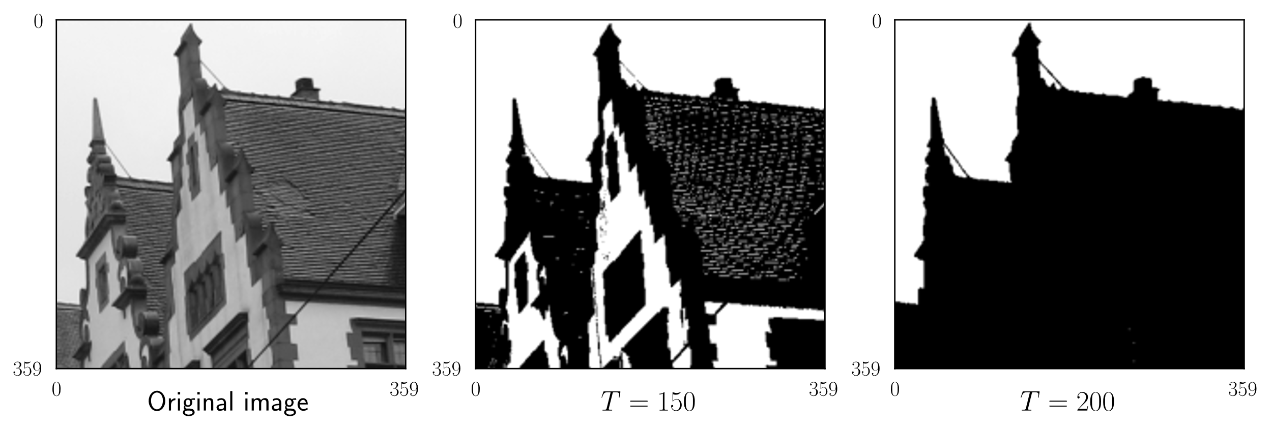
Some examples of an original black and white,and the threshold image of it…………………..

Slide 7
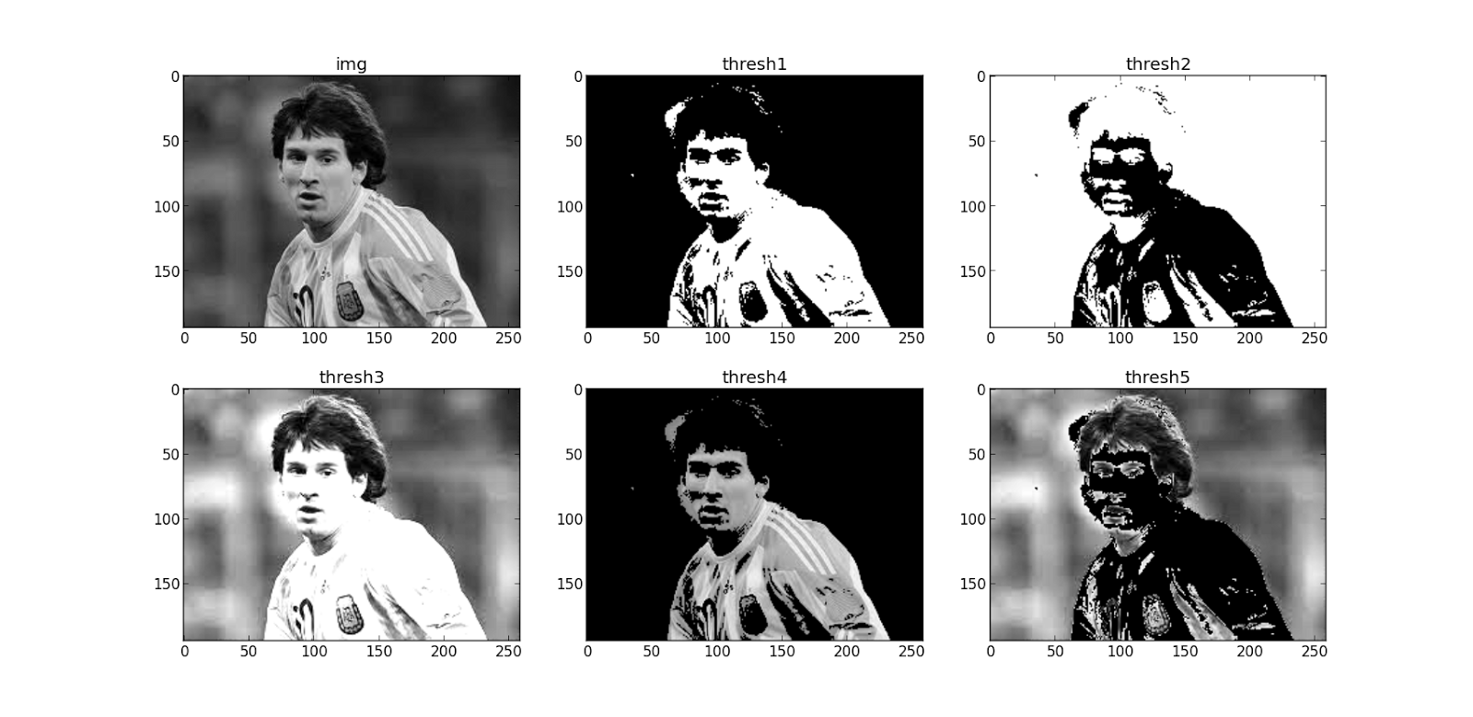
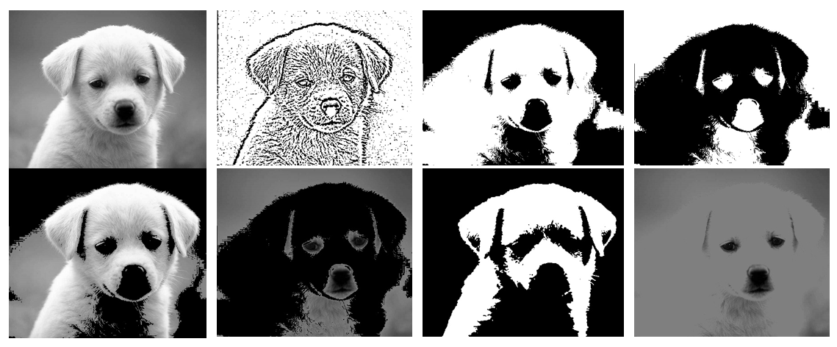
Some examples of an original black and white,and the threshold image of it and for different values of treshold that we give…

Slide 8
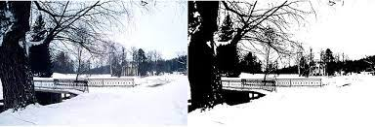
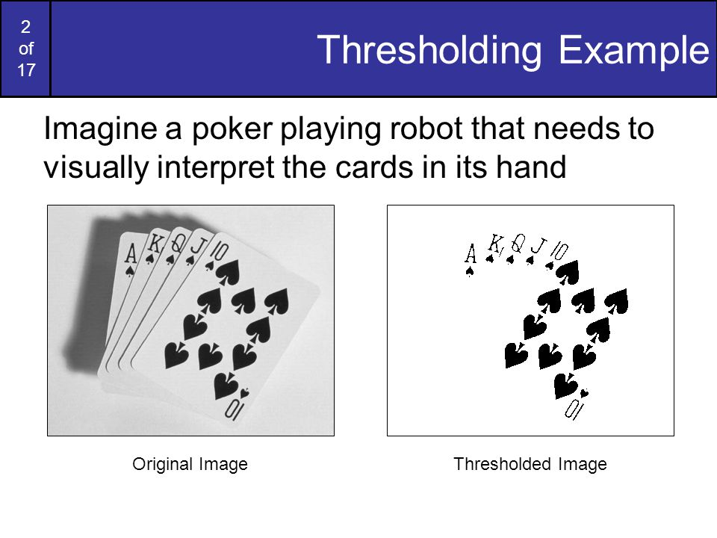
Some examples of an original black and white,and the threshold image of it…………………..

Slide 9
Thresholding is a technique that is applied to convert a grayscale image into a binary image, meaning it only has two colors: black and white. The process of thresholding involves comparing each pixel in the image to a threshold value, Pixels with a value greater than the threshold are assigned one color (e.g. white) and pixels with a value less than or equal to the threshold are assigned another color (e.g. black). This process results in an image that has only two colors, which is why thresholding requires only two colors.
Tresholding of an image can be applied only to gray-scale images,and cannot be applied to RGB images.

Slide 10
We can convert an RGB image to an treshold image ???????????
-we can’t convert an RGB image directly to an
Treshold image,can be done by converting the RGB image to grey-scale image and applying the same logic……………..

